Slide 1
Reinforcement learning for adaptive traffic light
Yanlin Yu
Supervisor: Giovanni montana

Slide 2
Why this Topic?
Increasing number of vehicles travel on roads. Traffic lights cannot set properly, which leads to more traffic jam.
Traffic lights are currently set on fixed timings.
Adaptive traffic lights can help improve this situation.
Reinforcement learning can be used on traffic lights to make better decisions in different situations.
Notes:
Traffic lane with no vehicle has a green phase, but at the same time, another lane with lots of vehicles has red light
Change not based on the road situation

Slide 3

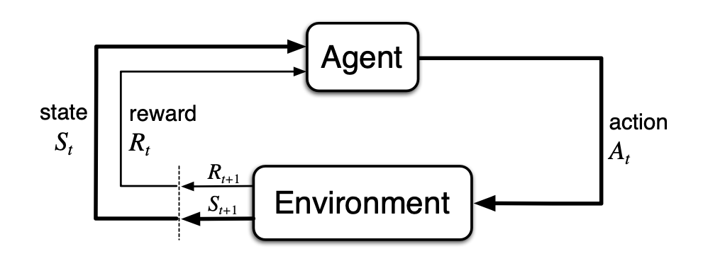

How Reinforcement Learning works
GOAL: maximize a numerical reward signal
S: is a set of states, called state space
A: is a set of actions, called the action space
$R_{a}$(S, S’): is the immediate reward received after transition from state s to s’ due to action a
$V^{∗}$(s) = $\max_{a}{Ρ\left(s^{′} | s,a\right)[R\left(s^{′} | s,a\right)+γV^{∗}\text{(}\text{s}’\text{)}]}$
.
Notes:
Starts in initial state in a specific environment;
take observation in each state and choose an action from action space and take this action to go to next state.
Every time agent select an action will give it a reward to evaluate how good is taking this action.
Agent learns from the previous experience.
what is a policy
Policy gives ideas to agent on how to select an action;
the reason to update it is to allow agent get better rewards in future step to satisfy the goal RL.
Goal of RL is maximised total rewards.
- Bellman equation: V* optimal value function; agent takes an action have the highest value of next state.

Slide 4
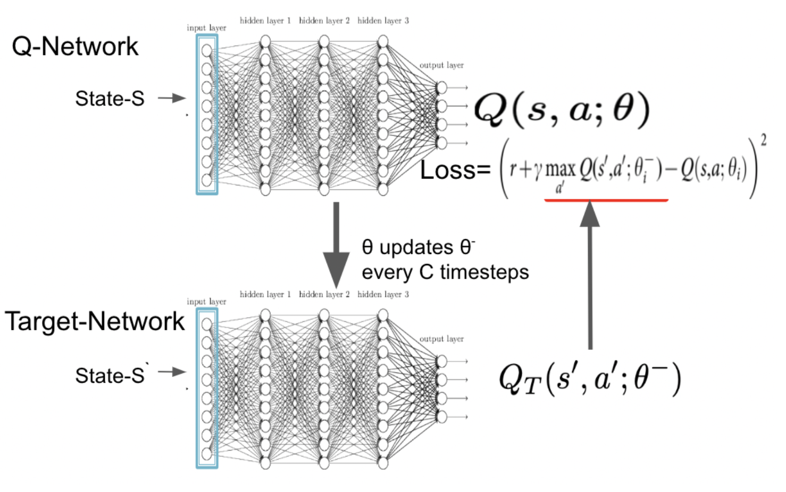


Methodology
In reinforcement learning (RL), the RL task can be abstracted into a Markov Decision Problem (MDP). The task is to train a policy to maximize the discounted reward.
Deep Q-Network (DQN): [1]
One approach to approximate the Q-learning algorithm is by using neural networks to estimate the value function.
$Q^{∗}$(s,a) =$Ε_{s}^{′}$[r+$γ\max_{a′}{Q^{∗}\text{(}\text{s}’\text{,}\text{a}’\text{)}}|(s,a)$]
Prioritised Experienced Replay (PER): [2]
Making the most effective use of the replay memory for learning
Use prioritised queue when storing experience, depends on the training loss of DQN. $𝒫\left(i\right)=\frac{p_{i}^{a}}{\sum{p_{k}^{a}}}$
[1]Mnih V, Kavukcuoglu K, Silver D, et al. Playing atari with deep reinforcement learning[J]. arXiv preprint arXiv:1312.5602, 2013.
[2]Schaul T, Quan J, Antonoglou I, et al. Prioritized experience replay[J]. arXiv preprint arXiv:1511.05952, 2015.
Notes:
RL to make agent have a better performance in an environment.
Q-learning: try lots of action, even it is wrong to learn an optimal policy; stores lots of (SARS) pairs; Q-value expected reward of taking an action in a state.

Slide 5
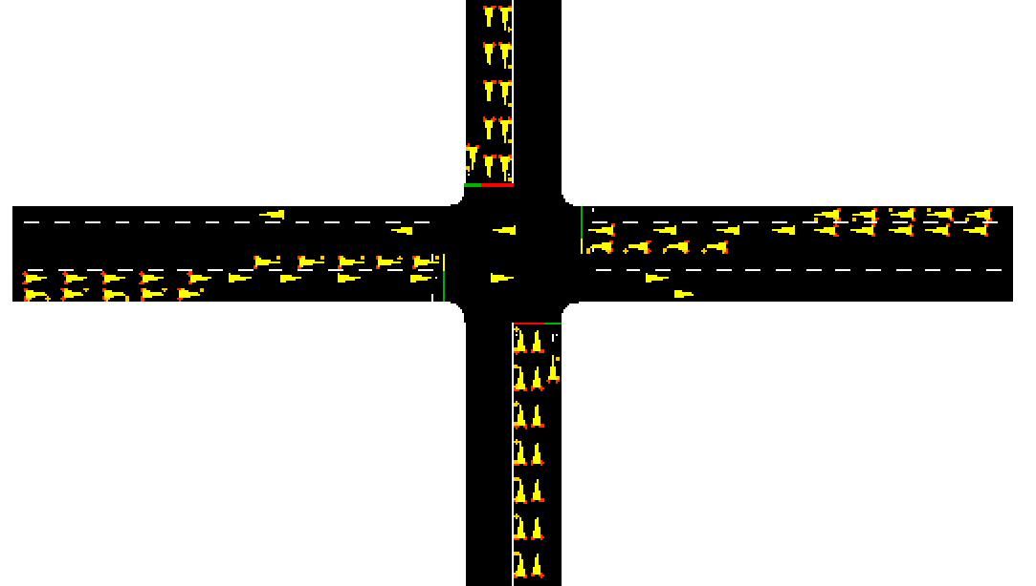
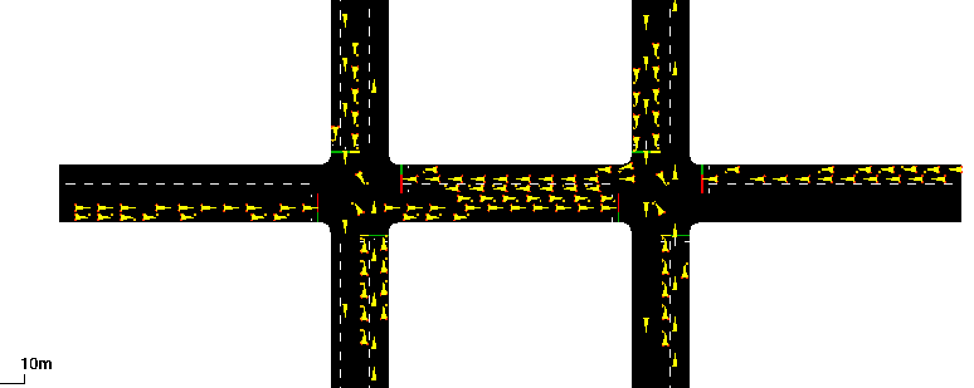

Environment/reward function [1]
Consist with (S,A,R,,S’) pairs
State: vehicle density of each traffic lane
Action: change the traffic light phase or not (red or green)
Reward: choose the lane with greatest density; turn its light green
Reward = $w_{1}$ * $\frac{Number of vehicles on lane}{Length of traffic lane}$ * Action
1 junction environment
2 junction environment
[1]Huang X, Wu D, Boulet B. Traffic Signal Control Using Lightweight Transformers: An Offline-to-Online RL Approach[J]. arXiv preprint arXiv:2312.07795, 2023.

Slide 6
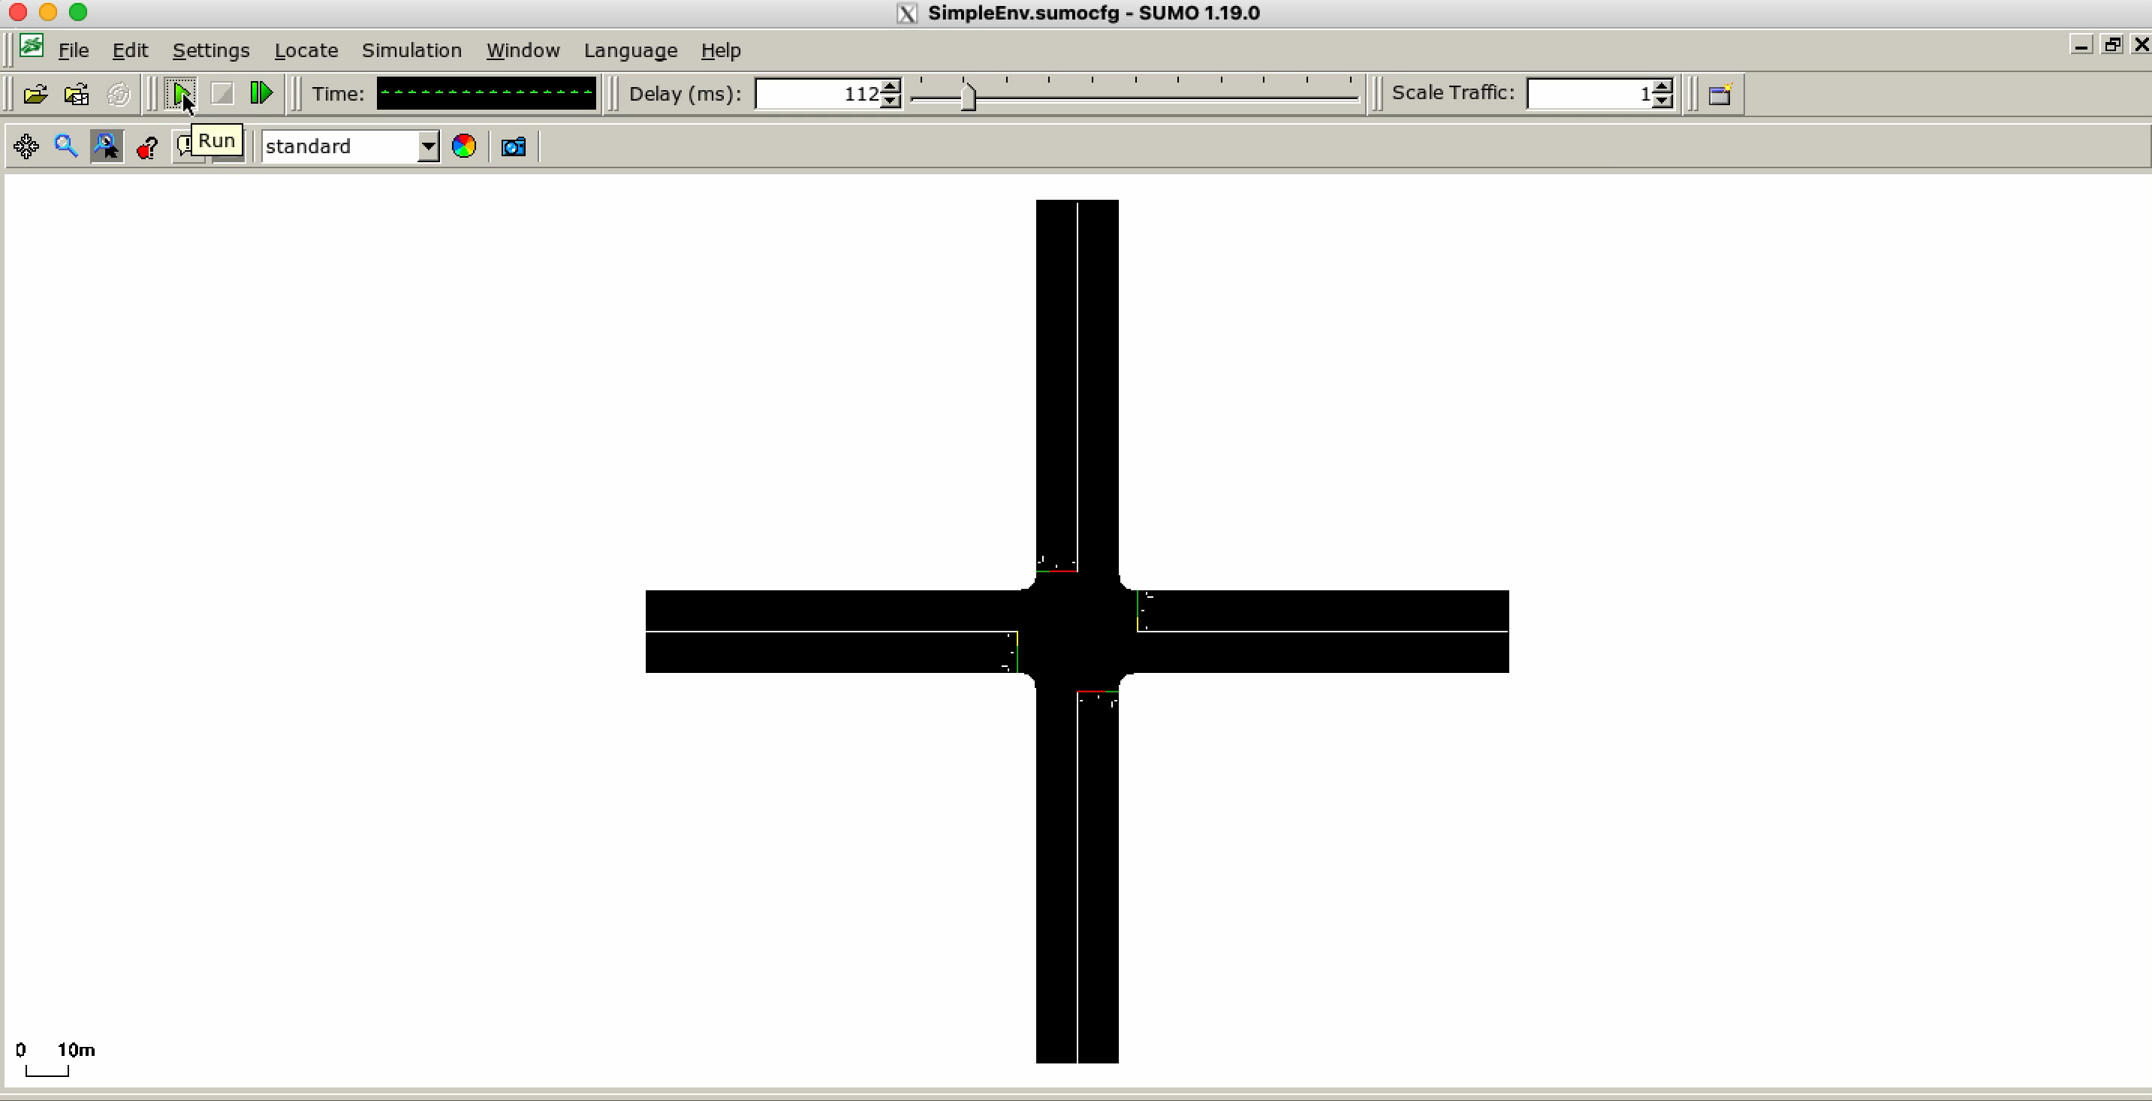
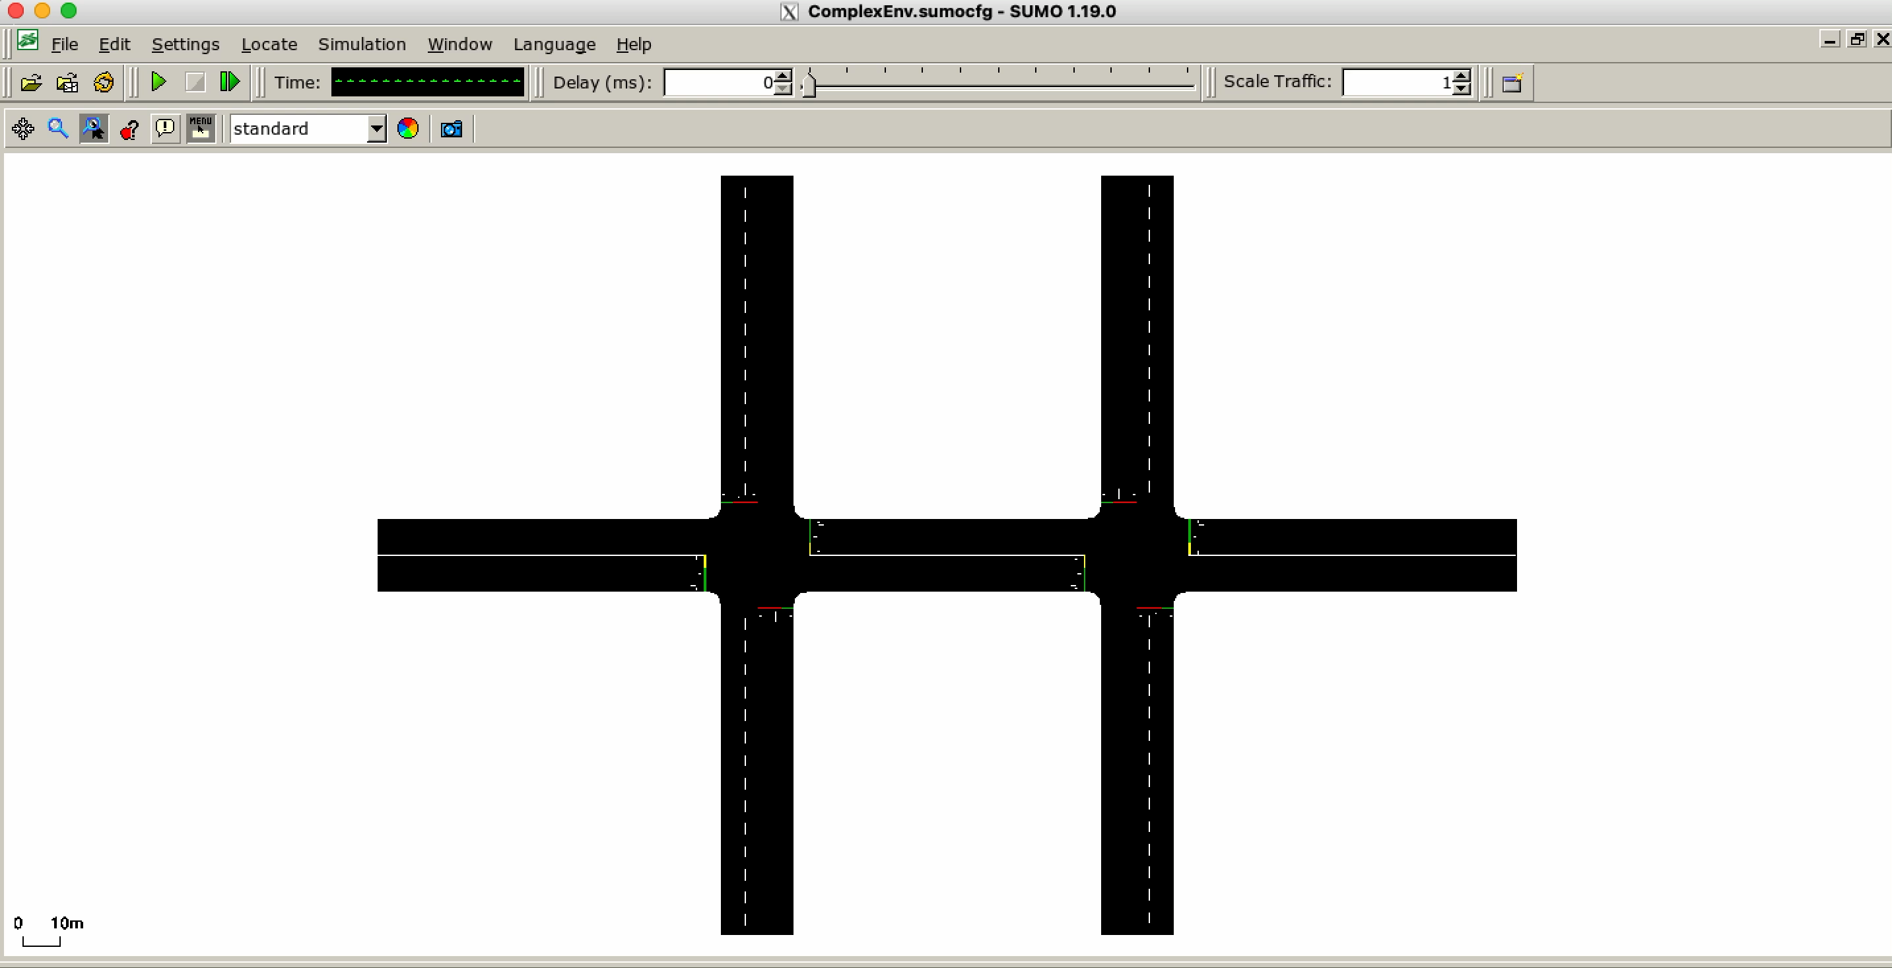
Training Period

Slide 7

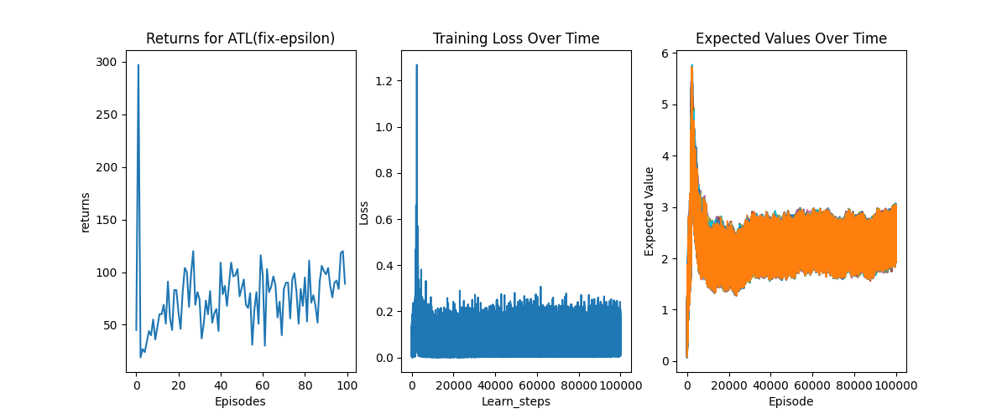
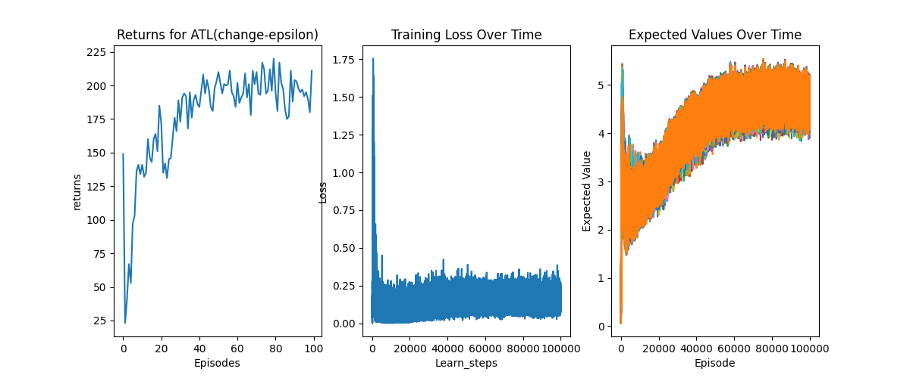
Results
Result for fixed exploration rate in DQN
Return is not stable during training. Very high return initially but low return during learning. However, a clear trend in expected value exist. Also, the loss value converges over time.
Result for Changing exploration rate in DQN
Returns have an increasing trend over time, which is better than with a fix exploration rate. Loss is high at the beginning and decreases over time.

Slide 8
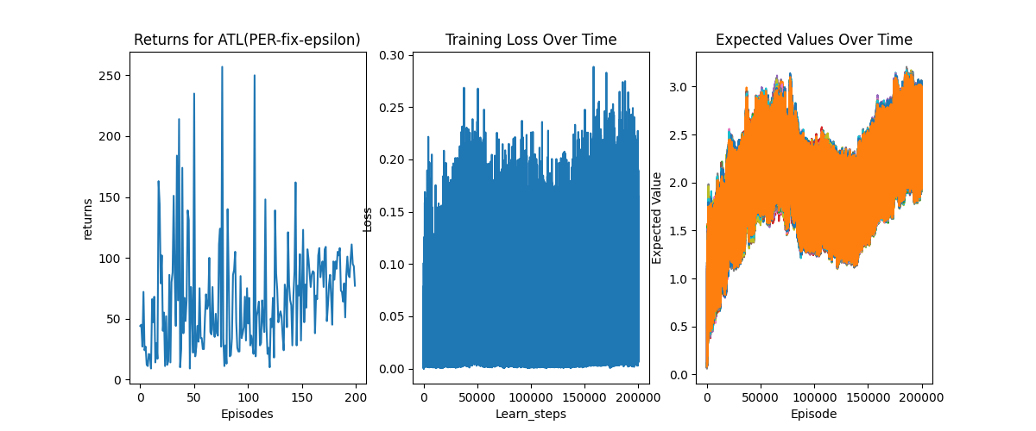
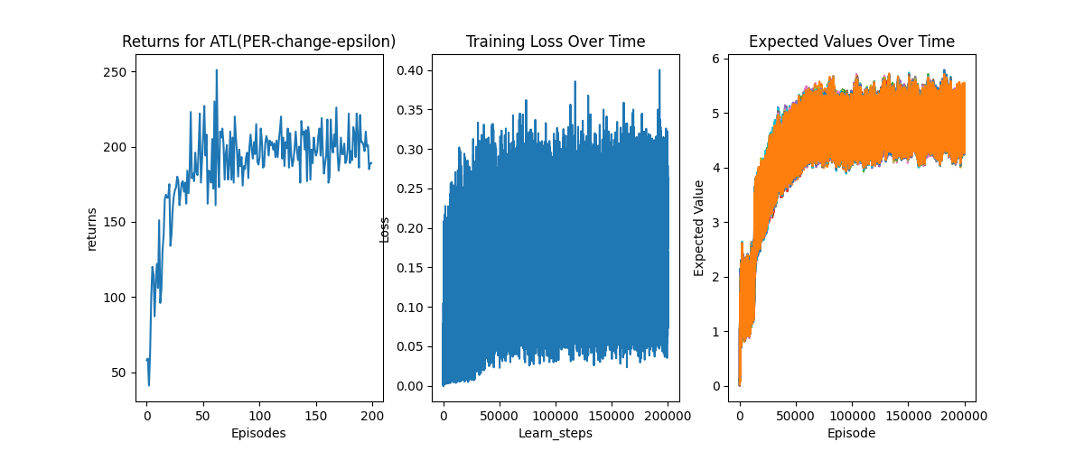
Fixed exploration rate with prioritised experience replay
Results
For fixed exploration rate, rewards still fluctuate over time. An overall increasing trend can be seen from expected Q values.
Changing exploration rate with prioritised experience replay
After applying PER, DQN with changing exploration rate has a better return over time – convergence can be seen earlier.

Slide 9
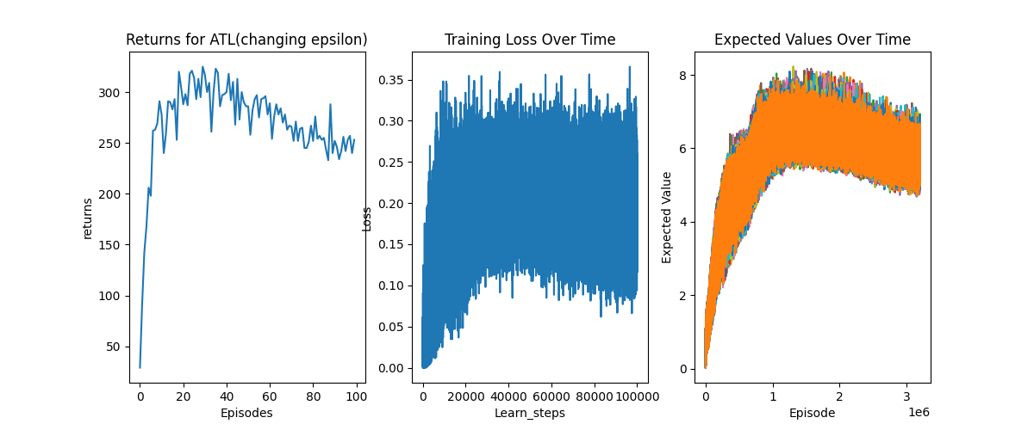
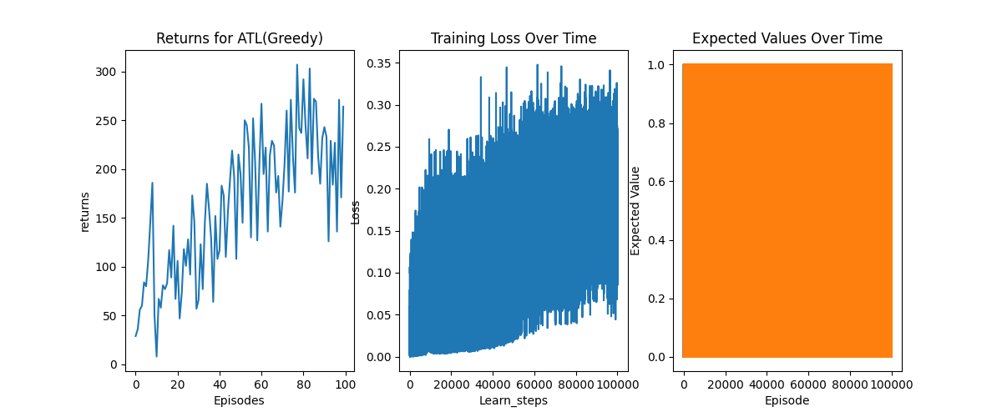
Result with different models
Result for DQN
DQN model works better than greedy algorithm, with higher returns over time and more convergence. A better trend can be seen from the expected Q values plot.
Greedy algorithm also works with increasing return but not stable during learning.
Cannot see expected Q values from plot.
Result for greedy algorithm

Slide 10
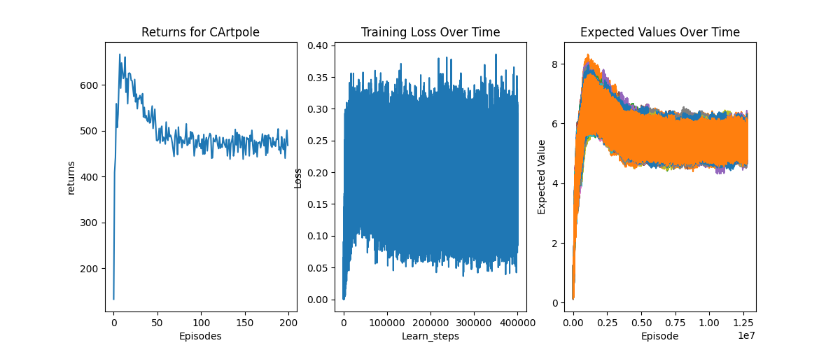
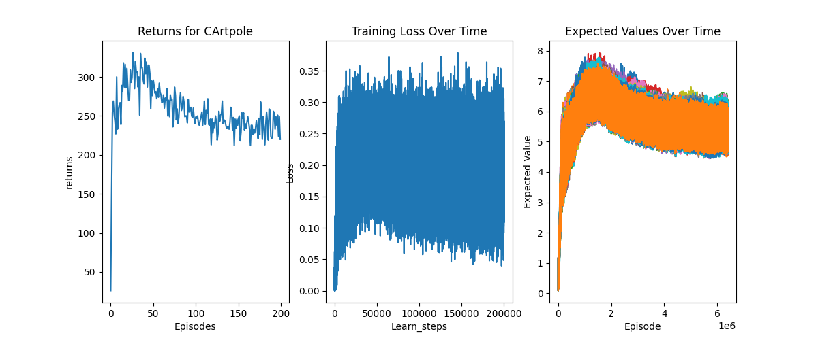
Limitation
The result of DQN may vary due to the different environment set up
Multi-intersection does not mean multi agent algorithm is applied, is a future work.
DQN may be sensitive to parameters – many parameters tested

Slide 11
Project Management
Project went well, all occurred difficulties have a solution given to it.
RL Environment is hard to set up generally; Many tests on environment to verify it can work properly.
Learning efficiency was not good. Prioritised experienced replay was added to help improve the efficiency.

Slide 12
Future work
More general environment, more traffic roles and conditions
Multiagent algorithms can be applied further, for example, game theory.
Try different algorithms on the environment
Notes:
4

